Slide 1
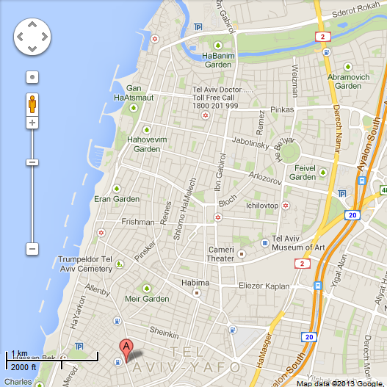
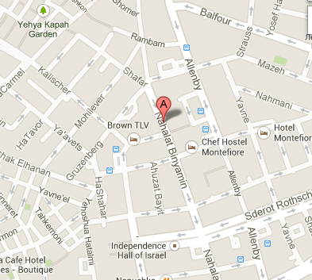
Dinner: Goshen restaurant Nahalat Binyamin street 37
Dinner at Kosher restaurant

